Slide 1

Datenattribute

Slide 2

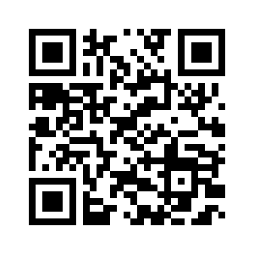
Dieser Comic wurde im Zuge des Forschungsprojekts Comixplain, gefördert von der Fachhochschule St. Pölten im Rahmen des Innovation Call 2022, erstellt.
Projektteam:
Victor-Adriel De-Jesus-Oliveira
Hsiang-Yun Wu
Christina Stoiber
Magdalena Boucher
Alena Ertl
Kontakt:
victor.oliveira@fhstp.ac.at
Illustrationen: Magdalena Boucher & Alena Ertl
https://fhstp.github.io/comixplain

Slide 3
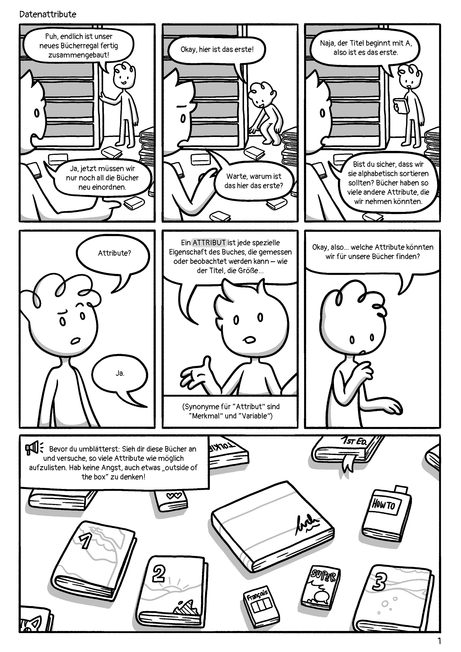

Slide 4
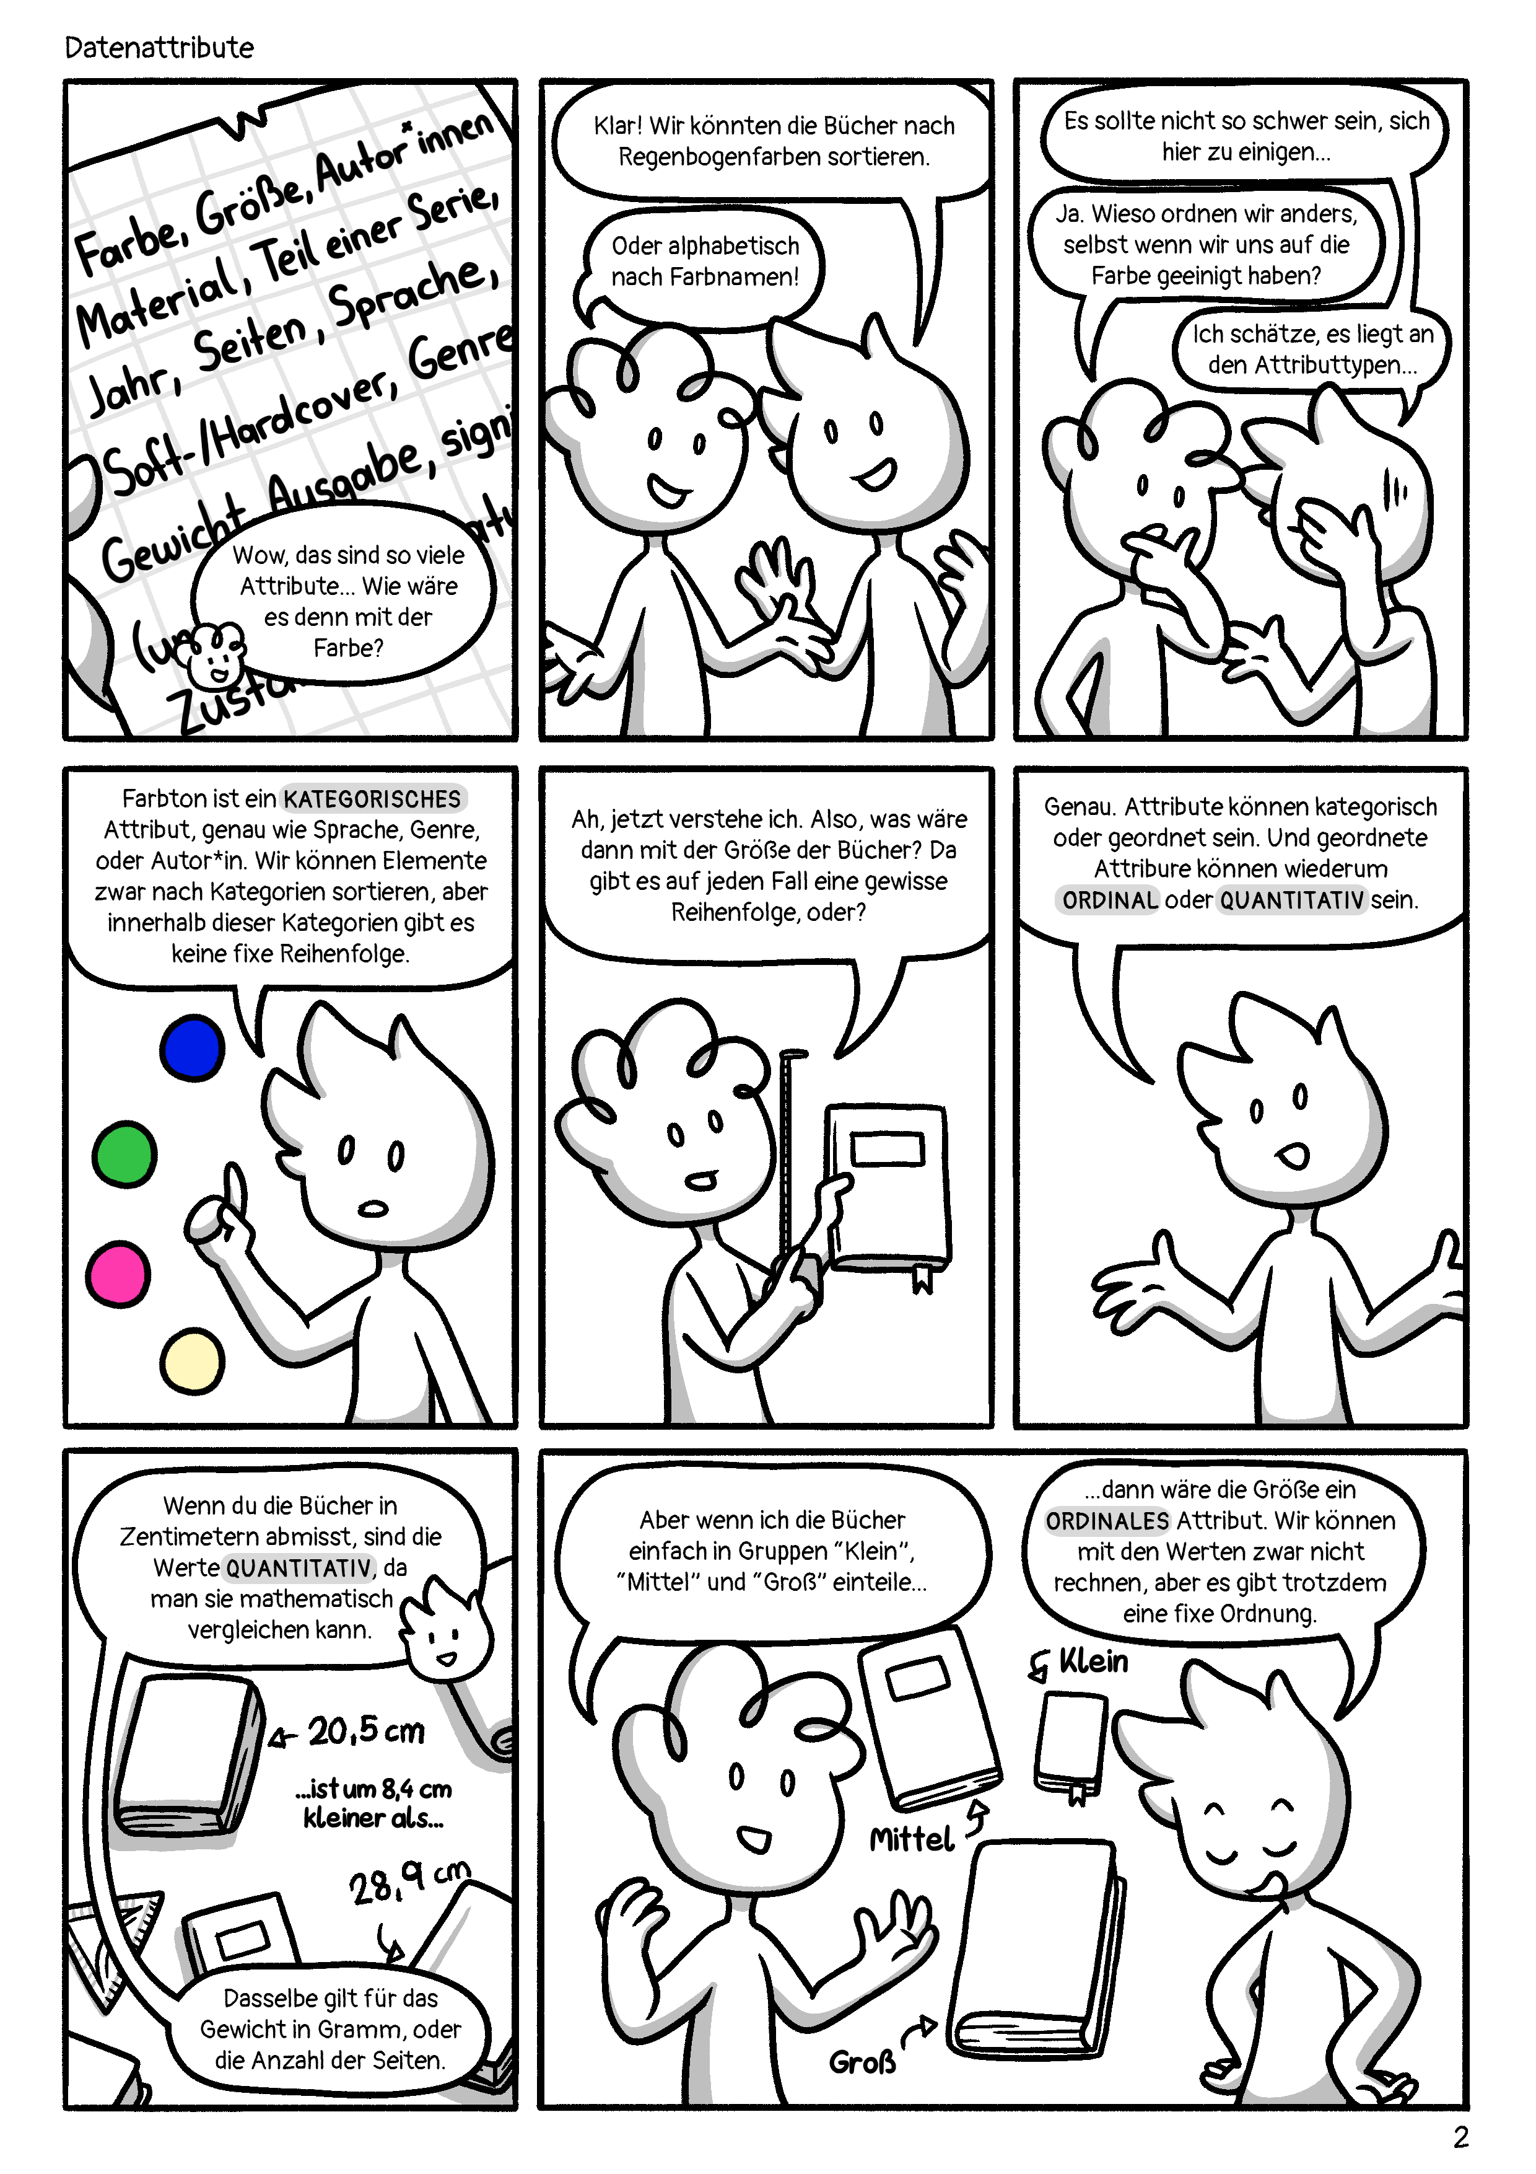

Slide 5
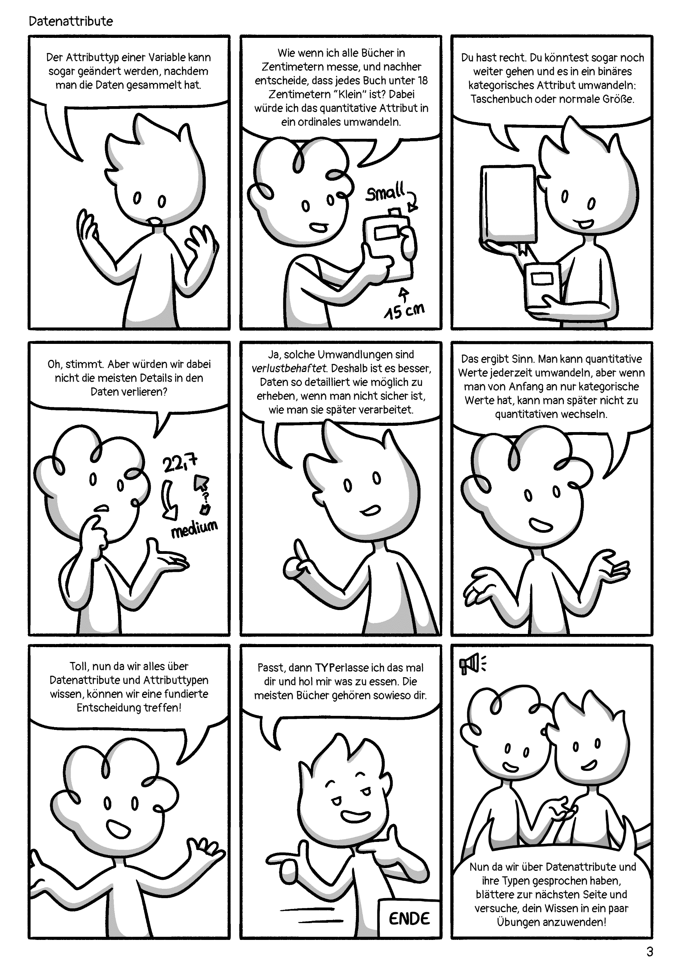

Slide 6
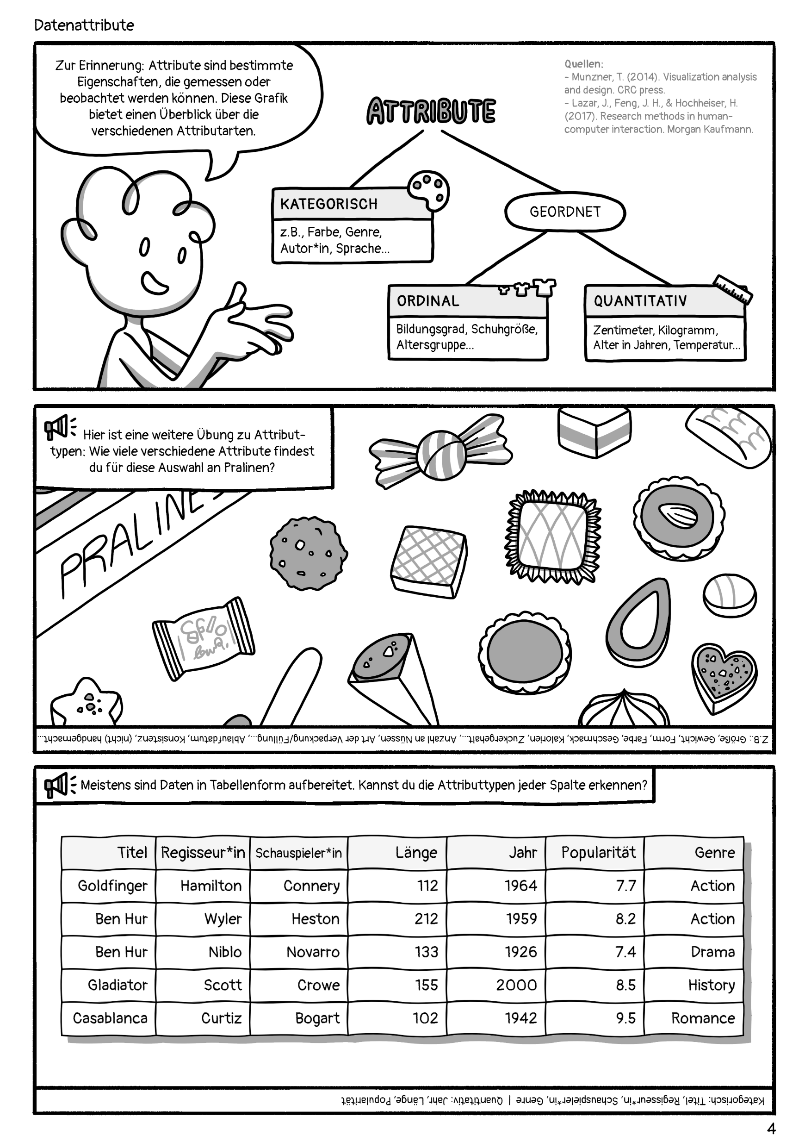

Slide 7
Quellen:
Munzner, T. (2014). Visualization analysis and design. CRC press.
Lazar, J., Feng, J. H., & Hochheiser, H. (2017). Research methods in human-computer interaction. Morgan Kaufmann.
Datenattribute © 2022 by Comixplain Team: Victor-Adriel De-Jesus-Oliveira, Hsiang-Yun Wu, Christina Stoiber, Magdalena Boucher, and Alena Ertl, with illustrations by Magdalena Boucher and Alena Ertl, all employed by Sankt Pölten University of Applied Sciences is licensed under CC BY-SA 4.0. To view a copy of this license, visit http://creativecommons.org/licenses/by-sa/4.0/

